Slide 1

Investsuite case
Holy Hackathon 2025

Slide 2
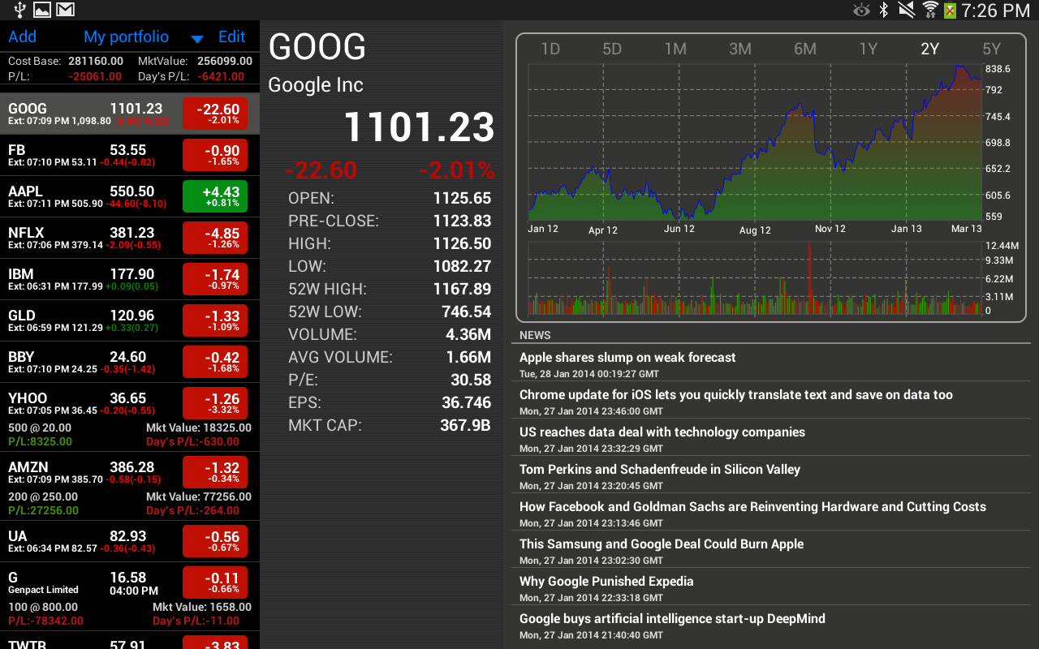
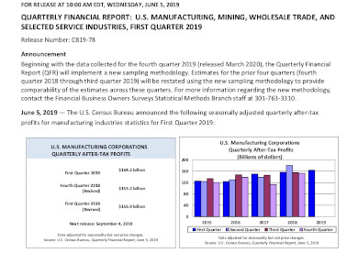
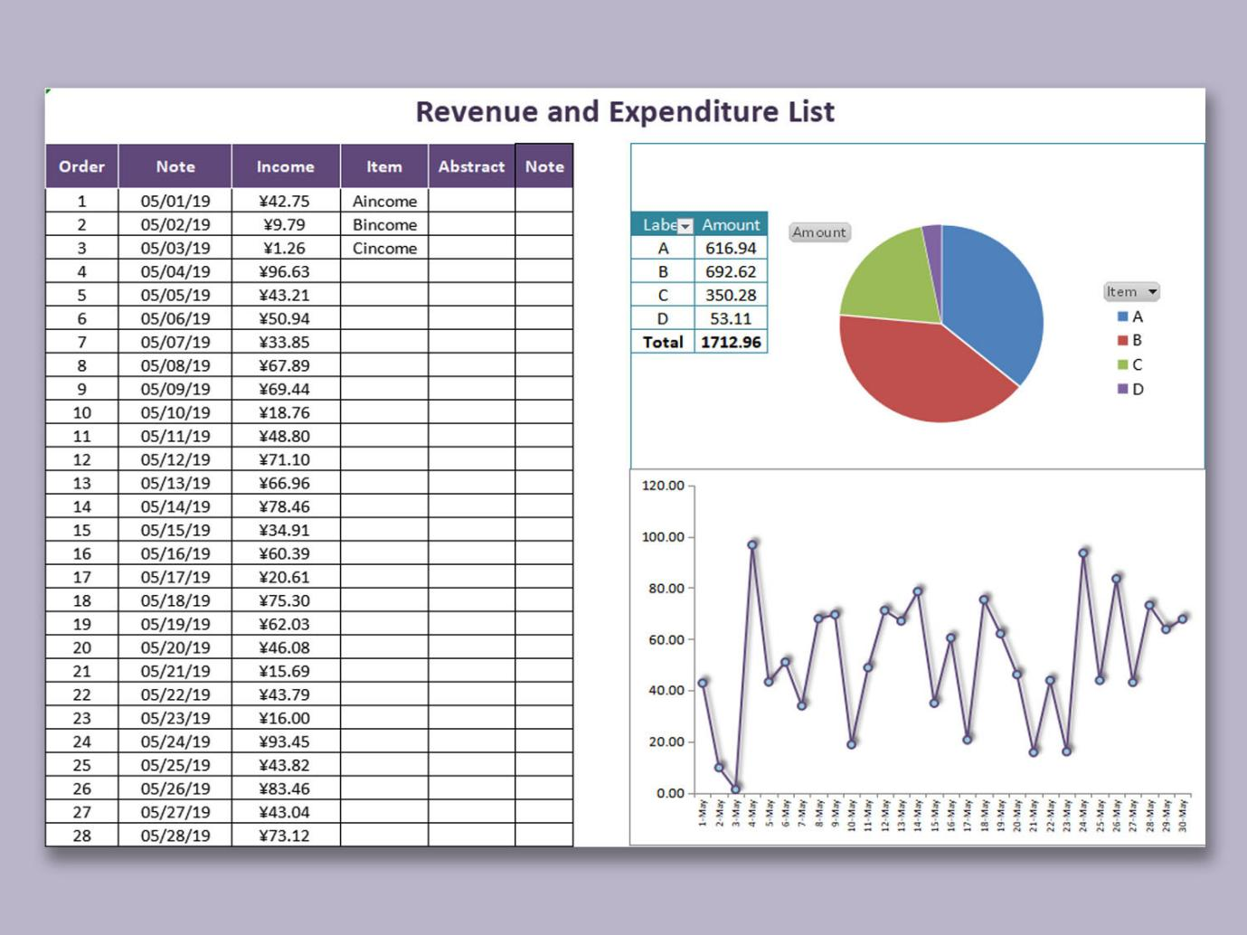
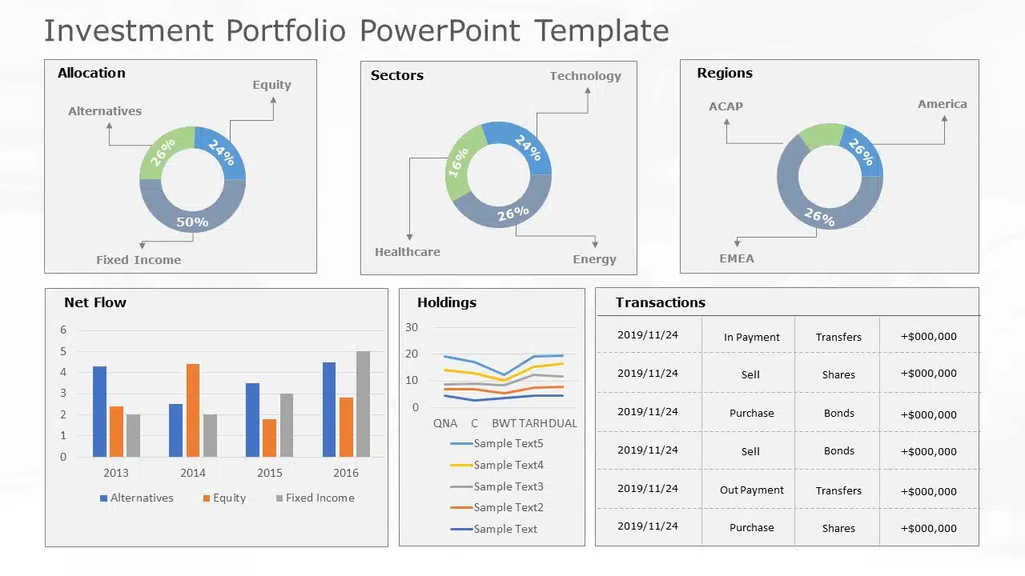
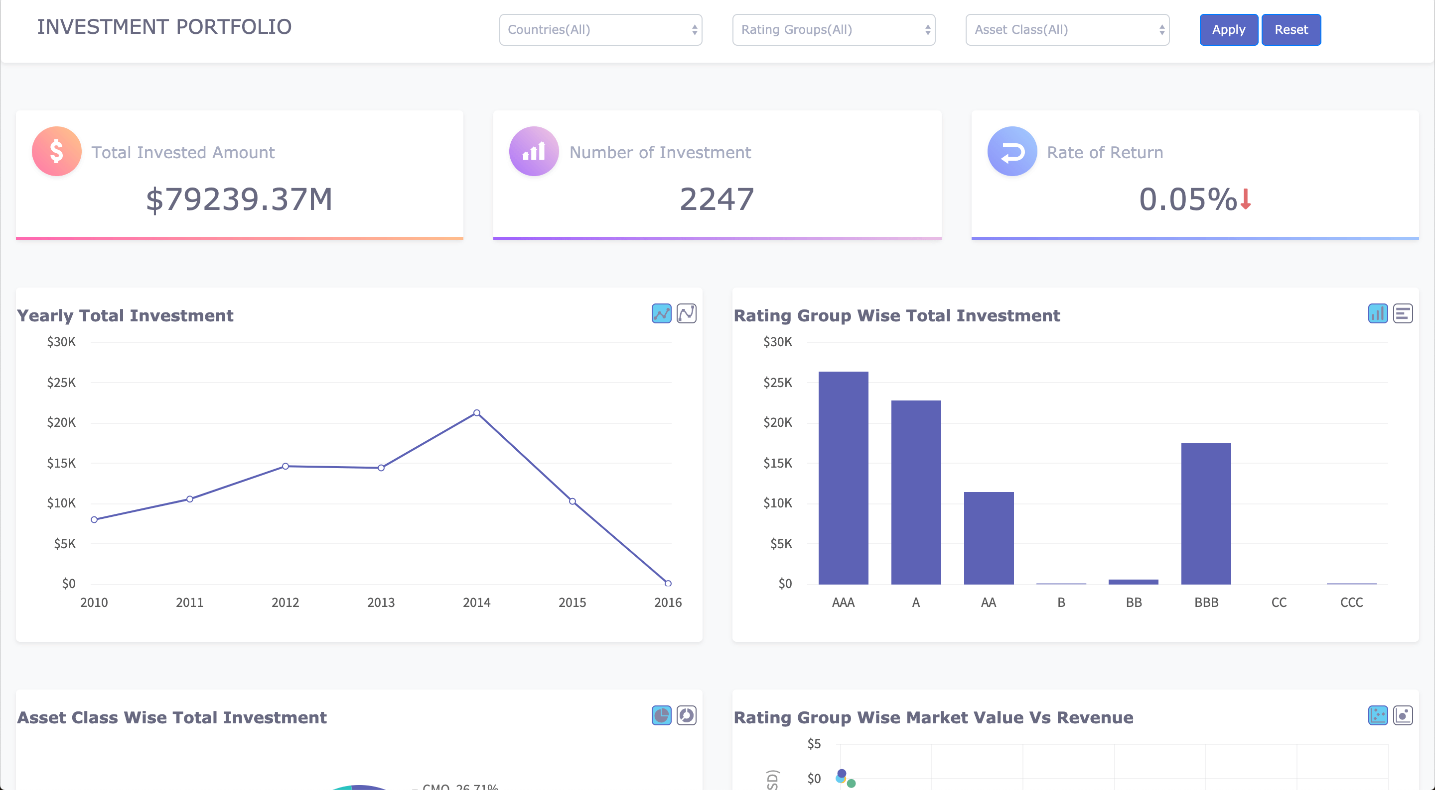
PROBLEM
People are interested in:
What happens with their money?
Why did their portfolio go up/down
So why are the reports not interesting?
Boring data reports
Complicated
Overwelming

Slide 3
Improvements
Target specific audience
Easy to use
Beginner friendly
Involve
Personalise

Slide 4
TARGET AUDIENCE
Young Professionals (18-35): Want to start investing but lack knowledge and motivation (46%)
Tech-Savvy Millennials: Love gamified experiences and social competition.
Students outside of finance: Need educational support and emotional feedback.
Grew up playing games: Clash of Clans, Hayday, Galaxy Life, etc.

Slide 5
Goals
inancial Introduction: Make investing simple, approachable, and stress-free.
dvise & Guide: Provide smart insights and learning opportunities
eimagine Portfolio Management: Turn passive investing into an interactive, visual experience.
ap a Clear Growth Journey: Help users track progress and make better long-term decisions.
F
A
R
M

Slide 6


F
A
R
FOLIO
M

Slide 7

What is Farmfolio?
Portfolio visualiser
Overview based on growth and health status of a crop
Visual progress
Education platform
Crash courses
Beginner friendly introductions
News
General
Specific
Community
Live chat
Posts

Slide 8


Interactivity
User journey
Create avatar
Select goals (e.g., Retirement, Crypto Adventure, Impact Investing)
Visual Progression
Learning place
Portfolio quiz
Let player guess their profits/losses
Show why company had profit/loss

Slide 9
Revenue Model
FREE | PREMIUM
Basic lessons Graphs and analytical info General advice Cosmetics based on Log-in streak Progress | Advanced lessons Extra data Exclusive advice from experienced investors More cosmetics, avatars, plants, background,…

Slide 10


Scalability
Software
Globally
Advertisements
Other sectors:
Language learning: Duolingo
Memorizing: Quizlet
Education: Brilliant
→ Finance?

Slide 11

What’s in it for you?
A thought out application for a specific audience
Enhancing financial literacy and investment insights for bank app users
A fresh, game-changing approach
What’s in it for the “farmers”?
A simple and quick way to get a snapshot of your current portfolio
A fun and insightful interactive learning app
Gain knowledge about investing and the stock market

Slide 12

DEMONSTRATION
Visual demonstation
shots)

Slide 13




Warren Buffett

Slide 14




Warren Buffett
Account
Notification
Portfolio
Log Out

Slide 15
Warren Buffett

Slide 16


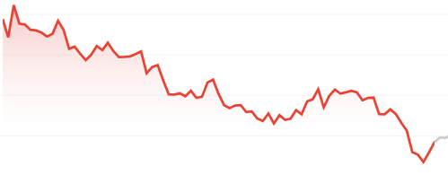

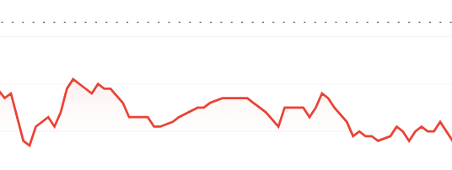

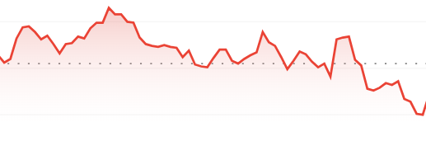

x
Warren Buffett
Warren Buffett
...
-
0
+
Apple Inc.: 193,34 EUR
−7,30 (3,36%) ↓ today
1
x
-
0
+
Colruyt Group: 37,96 EUR
−0,50 (1,30%) ↓ today
-
0
+
ASML Holding NV: 642,40 EUR
−3,10 (0,48%) ↓ today

Slide 17

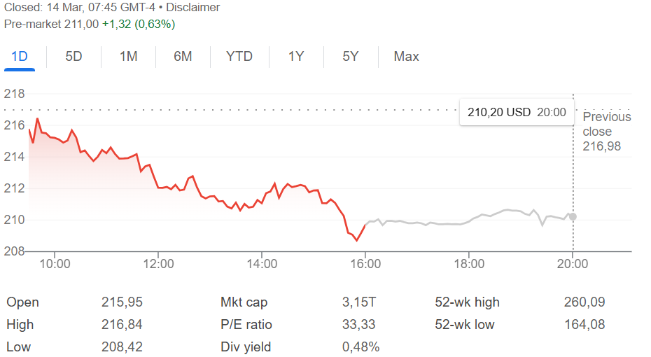

Warren Buffett
↓ 193,34
Apple Inc.
193,34 EUR
General
News
Community
−7,30 (3,36%) ↓ today
Apple Inc. (AAPL) is a leading tech giant on NASDAQ, known for its innovation and strong financial performance. It remains a top choice for investors seeking stability and growth.
#Apple #AAPL #Stocks #Investing #NASDAQ #TechStocks #StockMarket

Slide 18
Warren Buffett
Apple Inc.
193,34 EUR
General
News
Community
−7,30 (3,36%) ↓ today
Apple Inc. (AAPL) is a leading tech giant on NASDAQ, known for its innovation and strong financial performance. It remains a top choice for investors seeking stability and growth.
#Apple #AAPL #Stocks #Investing #NASDAQ #TechStocks #StockMarket

Slide 19
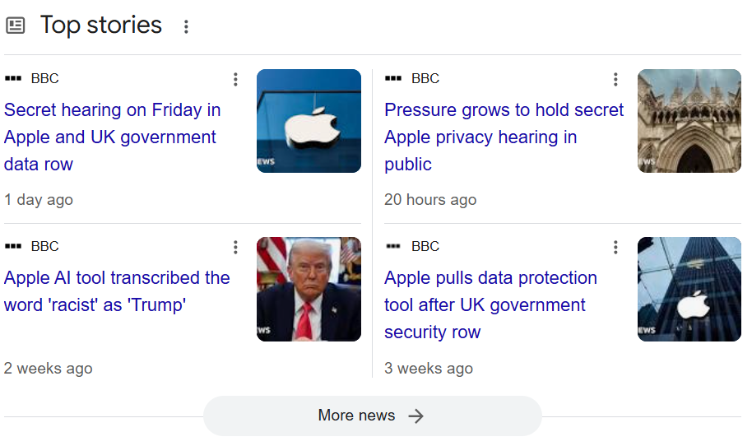
Warren Buffett
Apple Inc.
193,34 EUR
General
News
Community
−7,30 (3,36%) ↓ today
Apple Inc. (AAPL) is a leading tech giant on NASDAQ, known for its innovation and strong financial performance. It remains a top choice for investors seeking stability and growth.
#Apple #AAPL #Stocks #Investing #NASDAQ #TechStocks #StockMarket

Slide 20
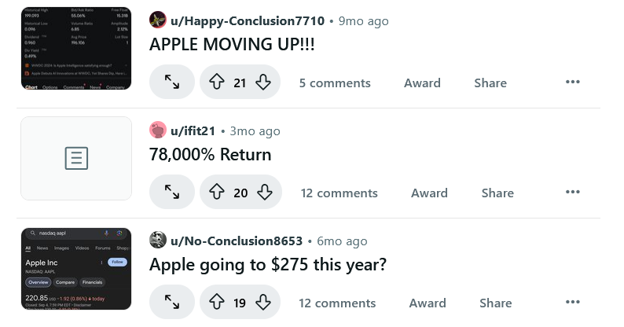
Warren Buffett
Apple Inc.
193,34 EUR
General
News
Community
−7,30 (3,36%) ↓ today
↓ 193,34
Apple Inc. (AAPL) is a leading tech giant on NASDAQ, known for its innovation and strong financial performance. It remains a top choice for investors seeking stability and growth.
#Apple #AAPL #Stocks #Investing #NASDAQ #TechStocks #StockMarket

Slide 21
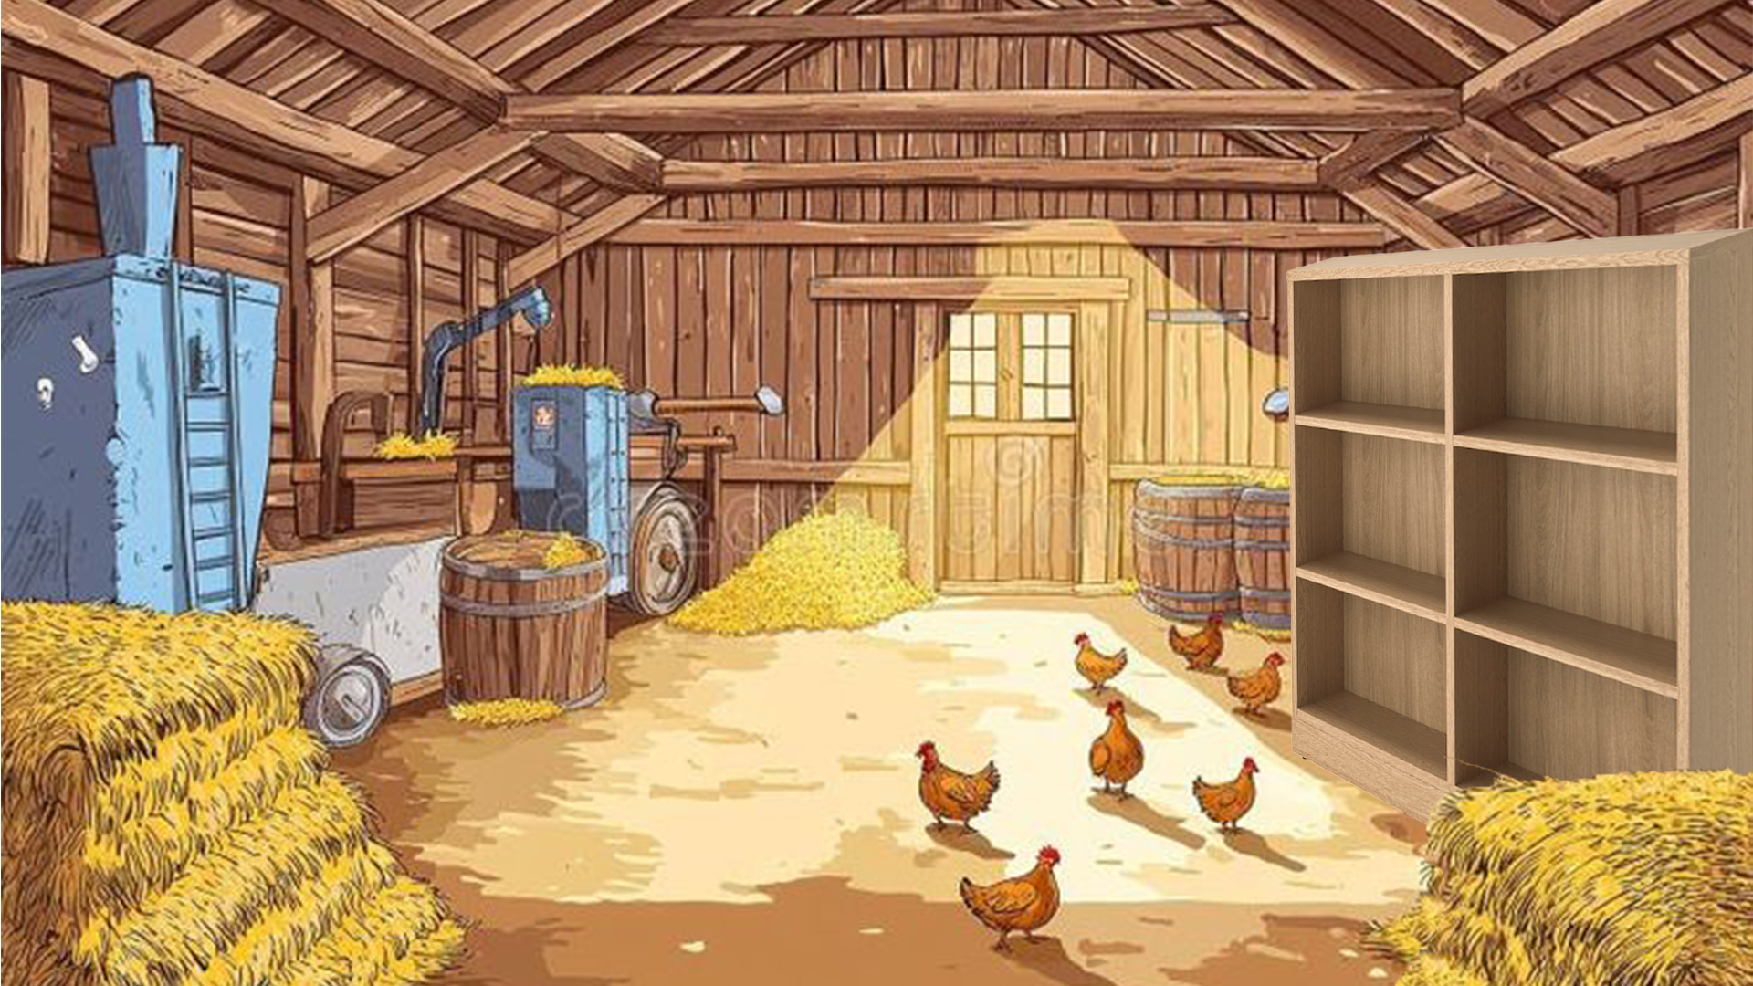

Warren Buffett
↓ 193,34
Risk and Return
Lessons
Lesson 1: Types of Investments
Lesson 2: Risk and Return
Lesson 3: Diversification
Lesson 4: Investment Strategies

Slide 22
Warren Buffett
Risk and Return
Lessons
Lesson 1: Types of Investments
Lesson 2: Risk and Return
Lesson 3: Diversification
Lesson 4: Investment Strategies

Slide 23

Warren Buffett
Risk and Return
Lessons
Lesson 1: Types of Investments
Lesson 2: Risk and Return
Lesson 3: Diversification
Lesson 4: Investment Strategies

Slide 24

Warren Buffett
Risk and Return
Risk and Return
Lessons
Lessons
Lesson 1: Types of Investments
Lesson 1: Types of Investments
Lesson 2: Risk and Return
Lesson 2: Risk and Return
Lesson 3: Diversification
Lesson 3: Diversification
Lesson 4: Investment Strategies
Lesson 4: Investment Strategies

Slide 25









435
Warren Buffett
Warren Buffett
435
435
234
234
↓ 15,4
↓ 193,34
233
435
↓ 164

Slide 26
DEMONSTRATION
Prototype demonstration

Slide 27

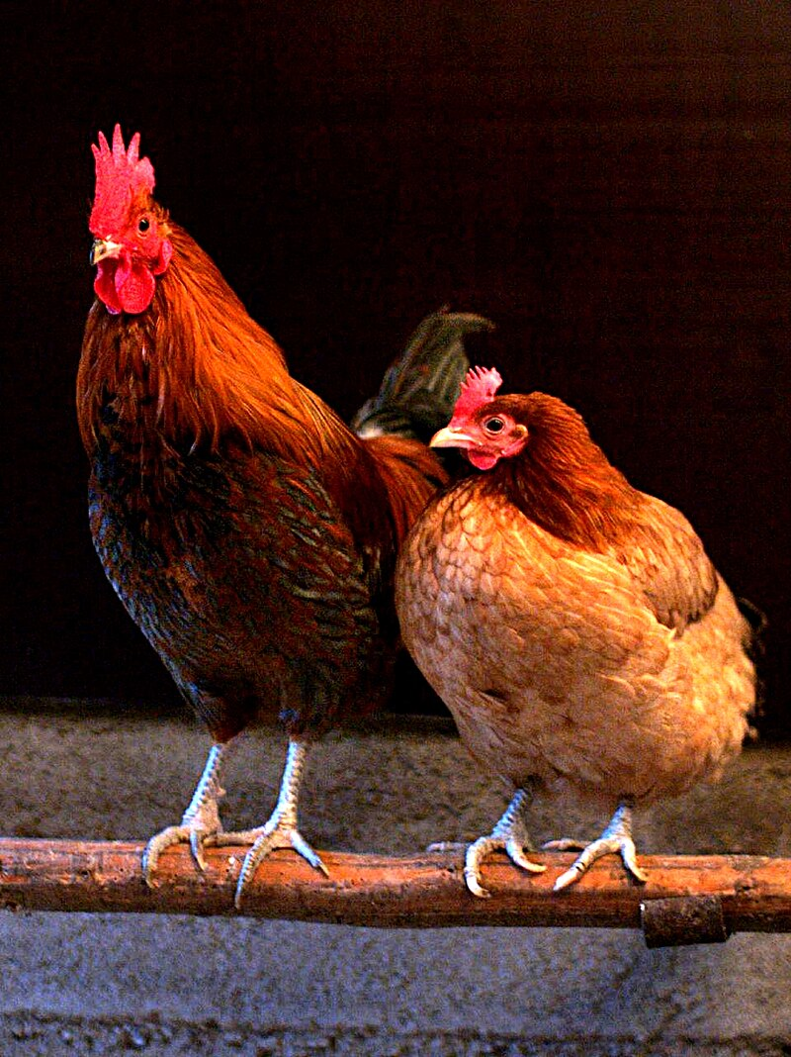


Cultivate success and enjoy the harvest!
Our mascot

